Slide 1

EchoWeather
~ A Weather Forecast Application
~ Sejal Chauhan

Slide 2

Introduction to EchoWeather
EchoWeather is a simple weather app that lets users check the current weather and a five-day forecast for any city.
Built using React and Vite for a fast, user-friendly interface.
Fetches real-time data from the OpenWeatherMap API.
Features include city search, temperature, humidity, wind speed, forecast, and a theme toggle (light/dark mode).
Responsive design–works smoothly on both desktop and mobile devices.

Slide 3






Key Features
Real-time Weather
5-Day Forecast
Theme Toggle
Current conditions at a glance.
Plan your week with confidence.
Customize your viewing experience.
Responsive Design
Robust Error Handling
City Search
Seamless experience on any device.
Graceful recovery from issues.
Find weather for any location.

Slide 4






Technologies Used
React
Vite
OpenWeatherMap API
Dynamic UI components.
Fast development setup.
Reliable weather data source.
CSS
HTML
GitHub
Styled user interface.
Structural foundation of web pages.
Version control and collaboration.

Slide 5






How EchoWeather Works
Enter City Name
User types a city name in the search bar.
Send Request
The app sends a request to the OpenWeatherMap API to get weather data.
Receive & Process Data
API sends back current weather and 5-day forecast information, which the app then processes.
Display Results
The app shows the weather details and forecast on the screen.
Handle Errors
If there’s an error (like city not found), an error message is displayed.

Slide 6
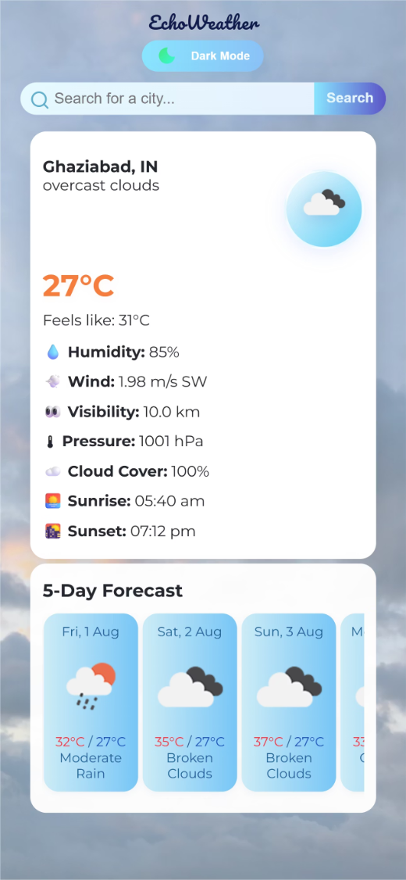
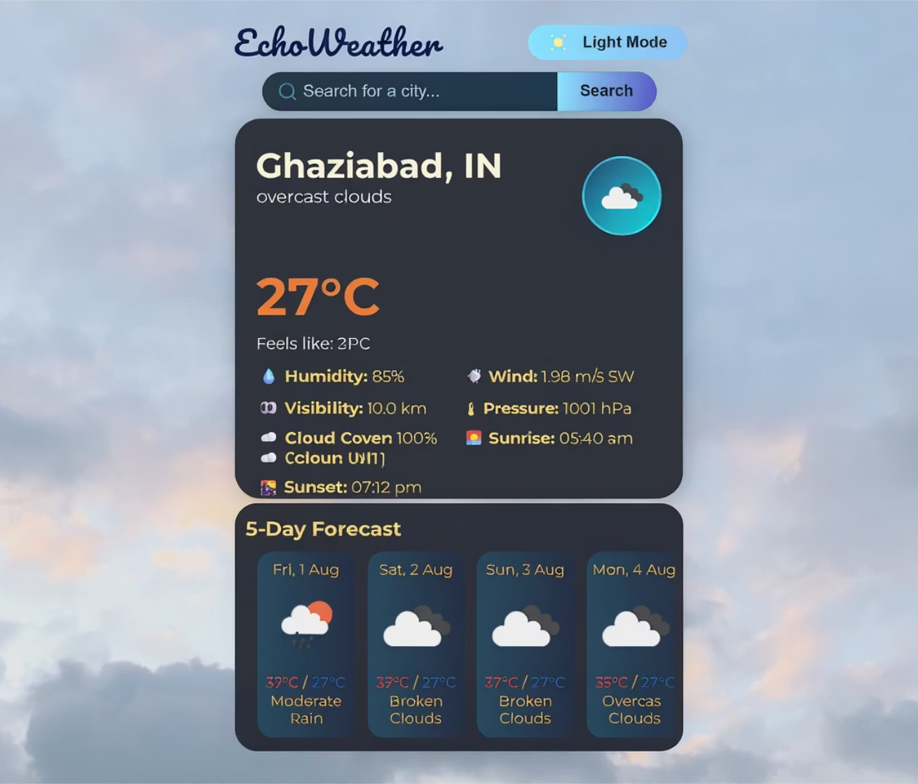
Visual Design/UI
Responsive UI Design

Slide 7
Challenges & Solutions
API Security
Responsive Design Across Devices
Problem: Exposing API keys client-side.
Problem: Adapting UI across various screen sizes.
Solution: I learned to store it in an environment variable using a .env file, which is excluded from the public repository.
Solution: Used a mobile-first approach with flexible CSS and media queries.

Slide 8

Future Improvements
1
Geolocation
2
Weather Alerts
Automatic weather for current location.
Notifications for severe conditions.
3
Detailed Forecasts
4
Interactive Maps
Hourly and extended weather insights.
Visual weather patterns and radar.

Slide 9
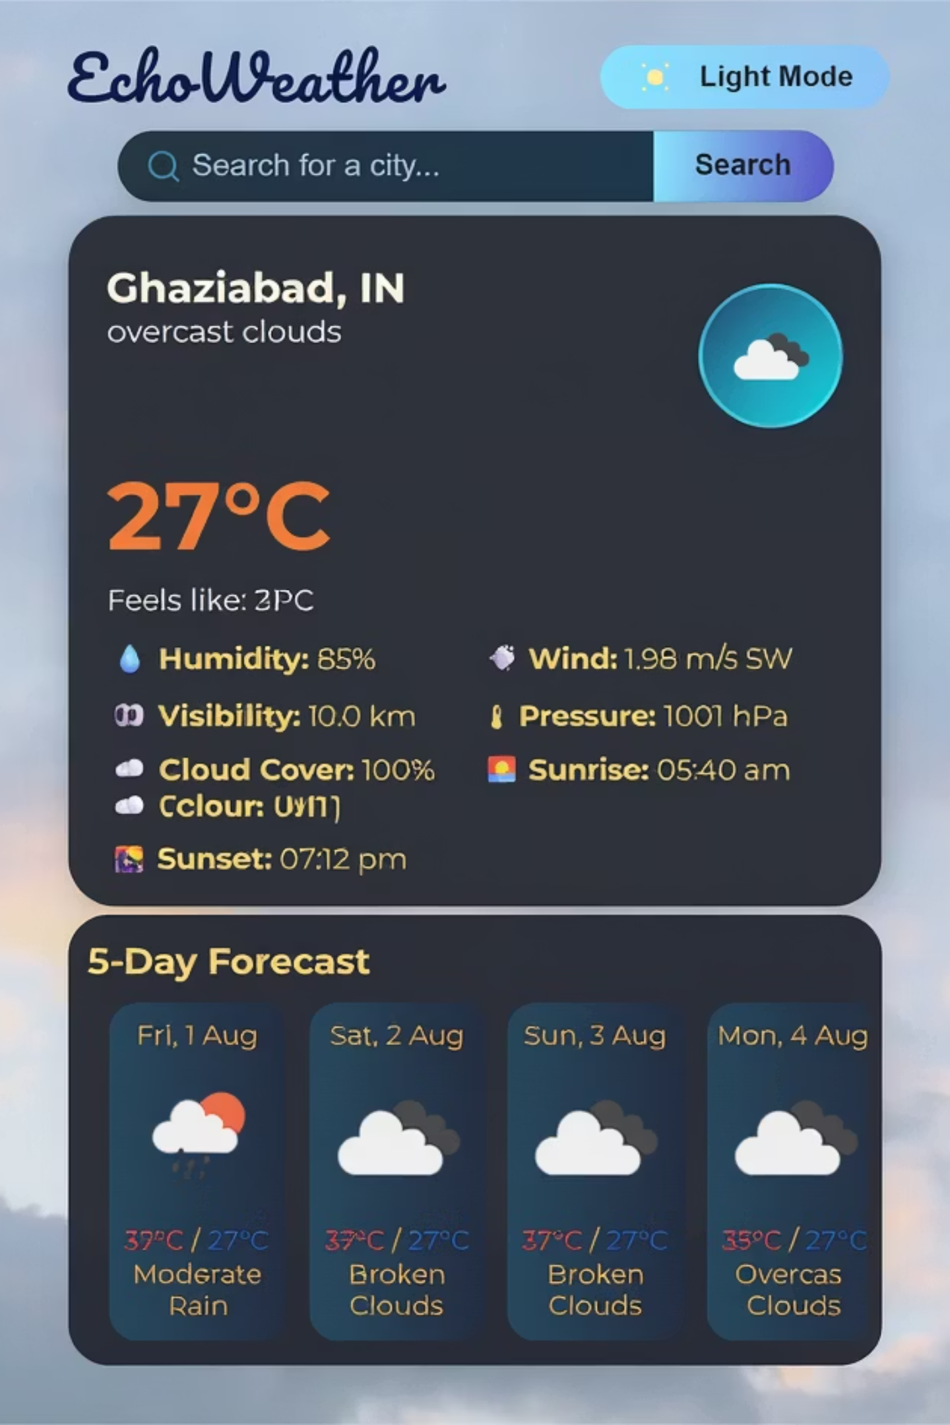
Conclusion
EchoWeather combines modern tech with user-centric design.
Key Learnings
Responsive design, API integration, and robust error handling.
Future Vision
Continuous improvement for a more dynamic and informative app.

Slide 10

Thank You!

